Slide 1
ENG4118/5326 - Robotics 4/M Sensors, Actuators and Image capture, processing and analysis
Lecture 13
Kevin Worrall

Slide 2

Lecture Overview
Brushless DC Motors
Stepper Motors
Motor Heating
Motor Control
Torque Requirements
Summary
Actuation Comparison

Slide 3
Brushless DC Motors

Slide 4
Brushless D.C. Motors
Brushless D.C. motors consist of a sequence of stator coils and a permanent magnet rotor.
Similarly to a current carrying coil experiencing a force within a magnetic field, the magnet itself will experience an equal and opposite force (Newton’s 3 rd Law).
In brushed D.C. motors, the permanent magnet is fixed and the coil rotates. With brushless D.C. motors, the current carrying coils are fixed and the magnet moves.
The rotor magnet is composed of ferrite or ceramic materials.
The current through the coils is electronically switched by transistors in sequence around the coils with the switching being controlled by the position of the rotor to ensure continued rotor rotation.

Slide 5
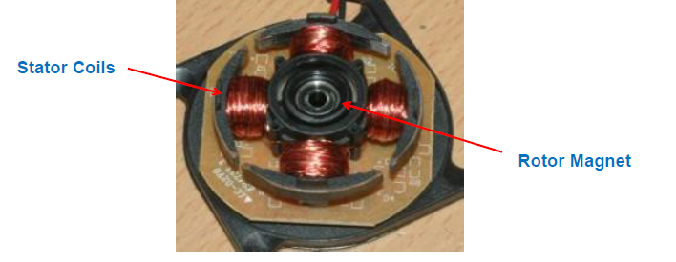
Brushless D.C. Motors
These motors have high reliability, low maintenance requirements, are quiet and capable of high speeds.
Note: an additional advantage of having the coils on the stator is that the majority of the heat is in the stator which is easier to cool than the rotor

Slide 6
Brushless D.C. Motors
https://www.youtube.com/watch?v=bCEiOnuODac

Slide 7
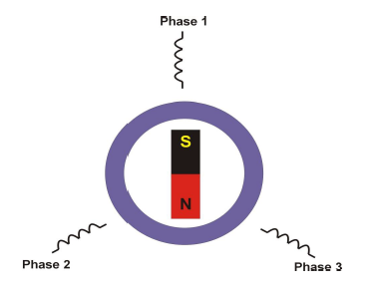
Brushless D.C. Motors
3-phase stator windings
Magnetic rotor structure
Phase windings energised sequentially in order to attract magnetic rotor
Control of phase currents results in control of motor torque

Slide 8
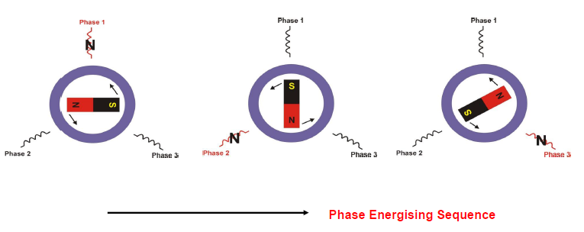
Brushless D.C. Motors

Slide 9
Stepper Motor

Slide 10
Stepper Motors
A stepper motor is a device that moves through equal angles, or steps, for each digital pulse supplied to its input.
They are robust, versatile and simple motors which are used in a variety of applications.
They are commonly used without feedback as the motor steps at a known angle for each input pulse and therefore its angular position is always known.
Stepper motors have a construction similar to brushless D.C. motors with a soft iron or permanent magnet core acting as the rotor and the stator composed of multiple coil windings.

Slide 11
Stepper Motors
There are generally three types of stepper motor:
Variable reluctance
Permanent magnet
Hybrid

Slide 12
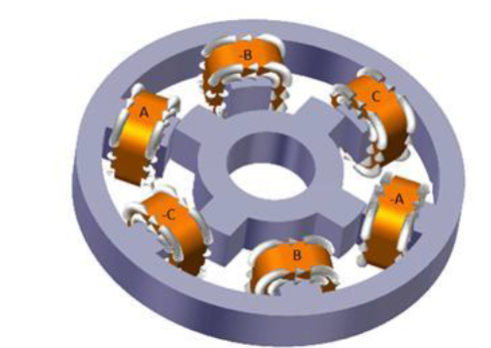
Stepper Motors - Variable reluctance
The system has a cylindrical rotor made of soft steel with four poles.
Stator coils are energised in opposing pairs creating a magnetic field across the rotor which will rotate to align itself with this magnetic field.
By sequentially energising and de-energising opposing coils the stepper can rotate in steps generally of 7.5 or 15 degrees.

Slide 13
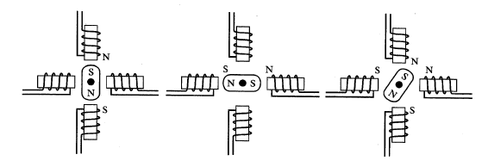
Stepper Motors - Permanent magnet
the rotor is composed of a permanent magnet and the stator has two coil winding pairs at a 90 degree offset.
By energising a coil pair with a d.c. current, the rotor will rotate to align itself with the magnetic field
By energising alternate coil pairs with currents in alternate directions the rotor will rotate in 90 degree steps.
By increasing the number of coil pairs, 15, 30 and 45 degree step angles are obtained.

Slide 14
Permanent Magnet A.C. Motors (PMAC)
PMAC’s are composed of a permanent magnet rotor and a stator composed of winding coils with an a.c. current passed through them
The number of current coils used determines the phase difference between the a.c. current passed through each of the coils e.g. a 3 coil system would each have a.c. currents 120 degrees out of phase
Because each of the coils have maximum currents at different times the magnetic field produced by the coils rotates about the stator poles, completing one rotation in one full cycle of the current
The speed of rotation of the magnetic field is termed the synchronous speed and the rotor will rotate at a rate 1 to 3% less than this speed

Slide 15
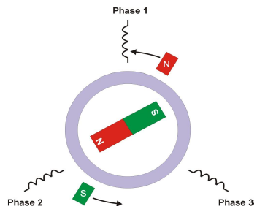
Permanent Magnet A.C. Motors (PMAC)
3 phase windings on the stator, spaced 120 degrees apart.
Sinusoidal phase (A.C.) currents with frequency fs and 120 degrees out of phase.
Sinusoidal phase currents controlled by rotor position
Motor rotates at (0.97 - 0.99)

Slide 16
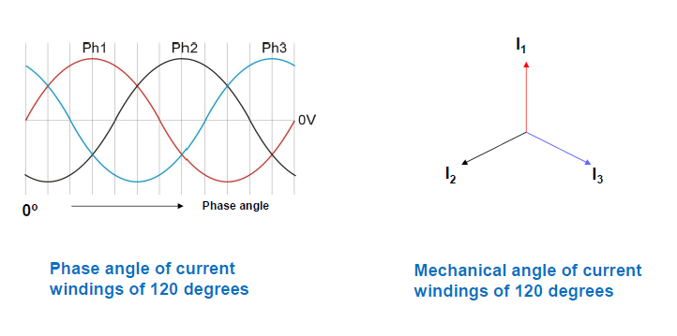
Permanent Magnet A.C. Motors (PMAC)

Slide 17
Brushed D.C. & A.C. Motors – Speed Control
D.C. motor speed is varied by changing the current flowing through the system.
For a constant load, an increase in current will result in an increase in speed and viceversa.
The speed of the A.C. motor is a function of supply current frequency and since this is generally constant the motor speed is constant.

Slide 18
Brushed D.C. & A.C. Motors – brushes
In a brushed motor, the lifespan of the brushes and commutators as well as the physical limitation of mechanical switching by brushes limits the lifetime of brushed motors.
In comparison, brushless D.C. , A.C. and stepper motors are sturdier and generally have a longer life

Slide 19
Brushed D.C. & A.C. Motors – Heat Dissipation
Like many devices, the heat generated by the motors ultimately becomes the limiting factor in terms of its size and power.
Heat is generated primarily by the resistance of the wiring to the electric current with thicker wires generating less heat but the drawbacks are added expense and greater
More important than the amount of heat generated is the rate at which heat is dissipated and therefore the path the heat must take to leave the motor.
In dc motors, the rotor contains the coil windings which carry the current and this is where heat is generated.
This heat must travel from the centrally located rotor through an air gap, through the remainder of the motor and finally to the environment, since air is a good insulator the heat transfer coefficient in this case is low.
AC motors have the current carrying coils as their stators and are located on the extremities of the motor. The heat transfer path is significantly shortened and through the motor casing only.
As a result of this, AC motors can be exposed to higher currents without damage and are generally more powerful for the same size of motor.

Slide 20
Motor Heating

Slide 21
Motor Heating
Overheating is one of the most common causes of failure for motors and can lead to:
Failure of winding insulation causing short circuits or burn outs
Failure of bearings, resulting in jamming of the rotor shaft
Magnet degradation, resulting in a reduction of motor torque

Slide 22
Motor Heating
Heat development in a motor is non-linear and is a function of the following:
Basic heat generated in the winding
Magnetic flux is degraded by heat, reducing torque and requiring additional current
Resistance of the coil increases with increasing heat
Heat dissipation requirements increase

Slide 23


Motor Heating
The heat generated by a motor can be written as:
where i is the current in the winding, R is nominal resistance of the winding and Rt is the resistance at temperature t, T is motor torque and Kt is the torque constant.
The variation in the winding electrical resistance can be described by:
where Rt and Rref are the resistance at the winding temperature, twinding, and the reference temperature, tref,and α is the temperature coefficient of the winding material.

Slide 24


Motor Heating
The torque constant representing the magnetic field of the motor varies with temperature as:
where Kt and Kref are the torque constants at the magnet temperature, tmagnet, and the reference temperature, tref,and β represents the decay of the magnetic flux.
The final temperature of the motor can be written as:
where Rthermal is the thermal resistance between the motor and the ambient and is a specific property of the motor.

Slide 25
Motor Heating
An example is provided in the Tutorial of how to calculate the heat
It is an iterative cycle
Various methods of reducing the heat
Duty cycle of the motor
Cooling system

Slide 26
Motor Control

Slide 27
Motor Control
How do we control the motors?
Simplest method on a DC Motor with 2 inputs is to apply a voltage between the inputs
This will cause the motor to run, potentially uncontrollable and may cause problems
If we control the voltage between the terminals we can control the motor
But how to do this?

Slide 28
Motor Control - Microcontroller
Microcontrollers are digital devices with inputs and outputs that can be controlled using a program
Typically, a microcontroller can only read inputs of 0 and 1 and can only provide outputs of 0 and 1 (e.g. 0 for < 0:8 V and 1 for > 2:4 V)
Though some microcontrollers have analogue out!
Any analogue signals must be digitised for use with a microcontroller using an analogue to digital converter (either external or built-in).
Similarly, if an analogue output is required this must be converted using a digital to analogue converter.
Unless there is one built into the microcontroller

Slide 29
Motor Control - Microcontroller
We can use the 0 and 1 output to drive a transistor on and off which in turns, turns the motor on and off
Never drive a motor directly from a microcontroller, unless you want to damage the microcontroller...
When the transistor is fully on or off the power loss in the system is zero but wastes lots of energy when raising or lowering its voltage

Slide 30
Motor Control – Pulse Width Modulation
How to reduce this power loss?
A method called pulse width modulation (PWM) can be used
PWM can create variable voltages with only one output port of the microcontroller without any loss of power in the transistors.
This is achieved by turning the output voltage of the microcontroller port on and off at a high rate which generates a pulse chain
Varying the length of time that the voltage is on or off will vary the average effective voltage.
The average output voltage changes as pulse duration, t1, versus pulse separation, t, varies.

Slide 31
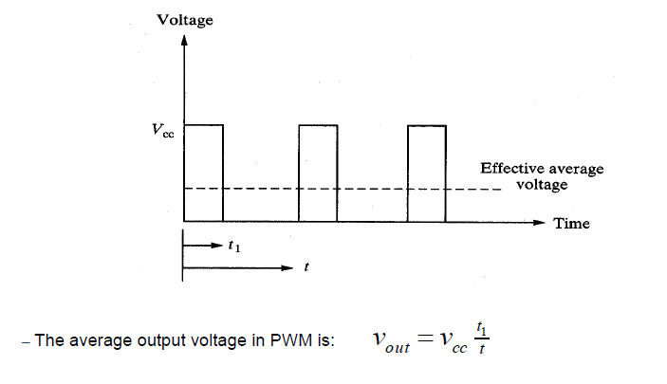
Motor Control – Pulse Width Modulation
The average output voltage changes as pulse duration, t₁, versus pulse separation, t, varies.

Slide 32
Motor Control – Pulse Width Modulation
The pulse rate of PWM may be 2 - 20 kHz, whilst the natural frequency of the motor is much smaller.
If the PWM switching rate remains much larger than the natural frequency of the motor’s rotor the switching will have little effect on its performance.
The motor effectively acts as a low pass filter and doesn’t respond to on/off signals except through the average value of the input voltage due to PWM.
One drawback of this technique is that it can create audible noise within the system, however this becomes inaudible as the frequency is increased beyond the hearing threshold for humans.
Theoretically there should be zero power loss in the transistor when it is switched on and off.

Slide 33
Motor Control – Pulse Width Modulation
It takes a finite amount of time for the voltage to build up or break down which results in heat generation which increases with frequency.
It is therefore crucial to use transistors with very high switching capabilities.
Additionally, as PWM increases, the back emf voltage in the motor also increases.
By varying the PWM timing continuously, a variable voltage can be created which can be used in brushless D.C. motors and other applications.
Sine wave generation using PWM can be seen to be composed of pulses of varying time durations.

Slide 34
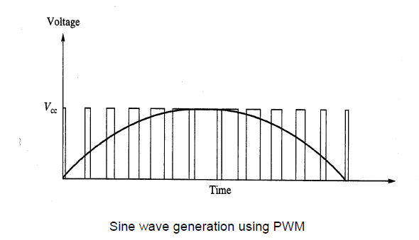
Motor Control – Pulse Width Modulation

Slide 35
Motor Control – Brushed DC
The speed of a permanent magnet motor depends on the current through the armature coil.
The speed can be changed by varying the armature current or the field current but it is usually the armature current that is varied.
Thus speed can be changed by varying the voltage applied to the armature but since fixed voltage supplies are used this variation is achieved using an electronic circuit and PWM.
PWM of the input signal is achieved by means of rapid switching of the transistor with a diode used to provide a current path for the current which arises when the transistor is off as a result of the motor acting as a generator.

Slide 36
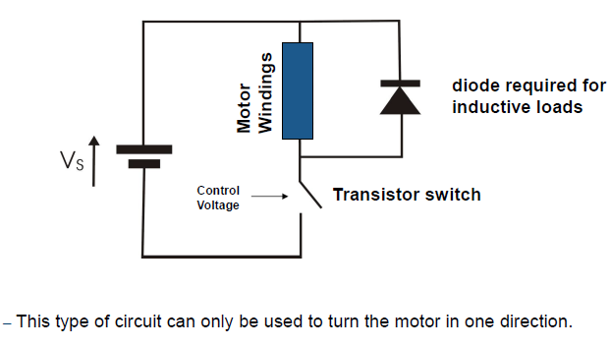
Motor Control – Brushed DC

Slide 37
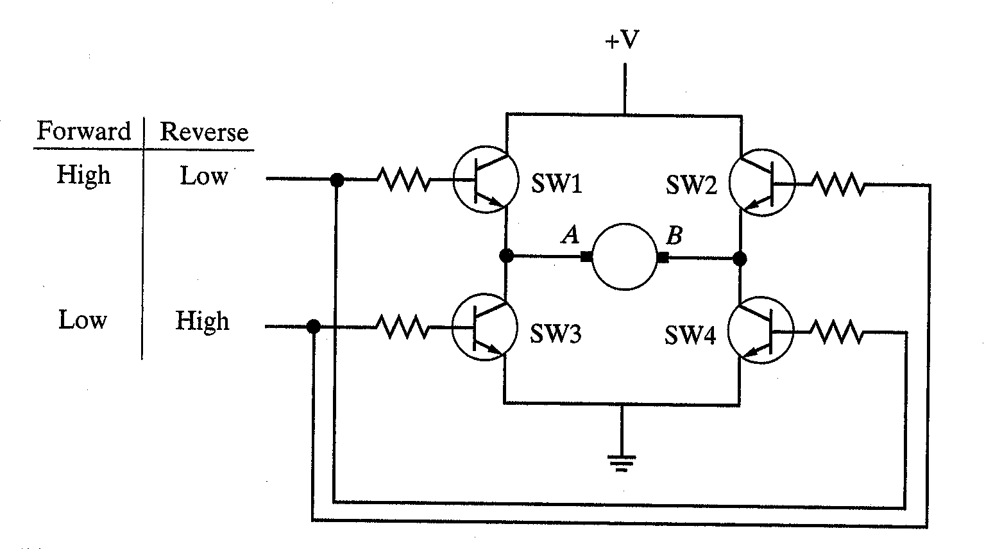
Motor Control – Directional Control
The direction of rotation of the motor can be changed without changing the direction of current flow using a circuit consisting of four transistors called a H-Bridge circuit.
When all four switches are off the rotor coasts freely.
In the H-Bridge shown, the motor moves in the forward direction when switches 1 and 4 are closed.
The motor moves in the reverse direction when switches 2 and 3 are closed

Slide 38
Motor Control – Directional Control
https://www.cs2n.org/u/mp/badge_pages/459

Slide 39
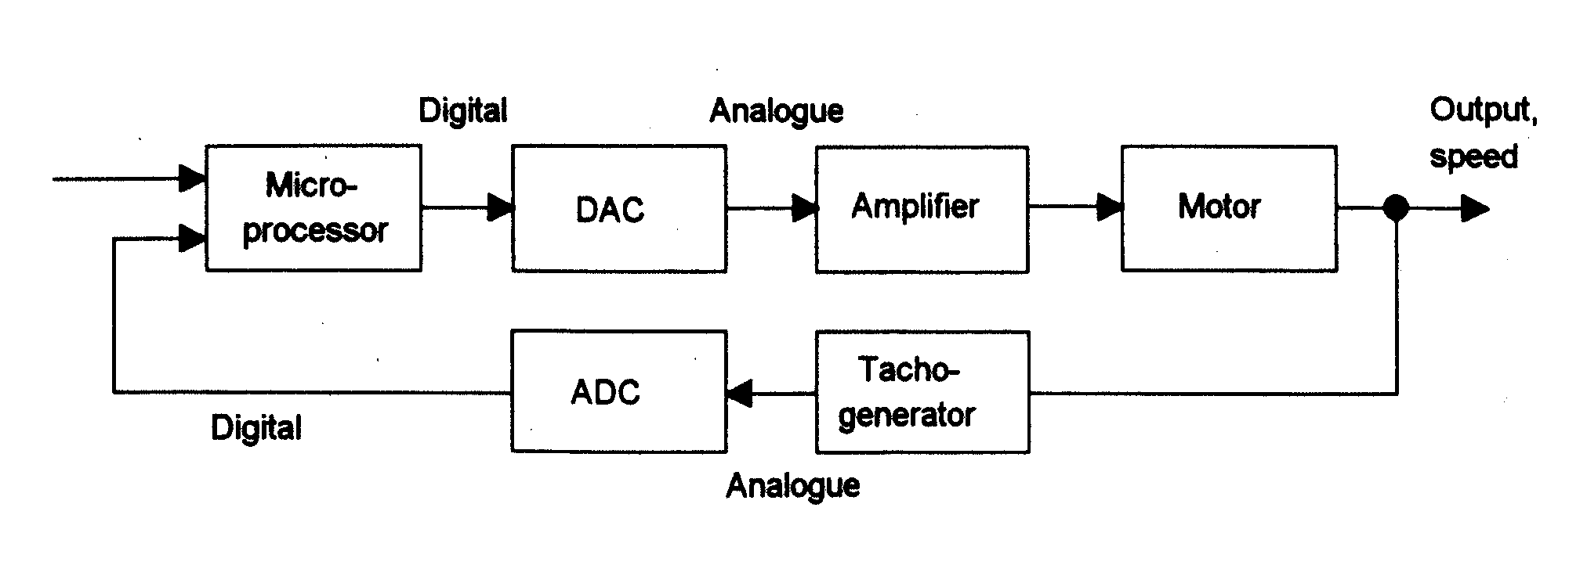
Motor Control – Directional Control
The H-Bridge circuit is an open-loop control system and assumes that the supply voltage and load driven by the motor remain constant.
A closed loop control system can be used to modify motor speed if conditions change.
A tachometer can be used to provide data on the motor speed which is used to create the error signal of the system.

Slide 40
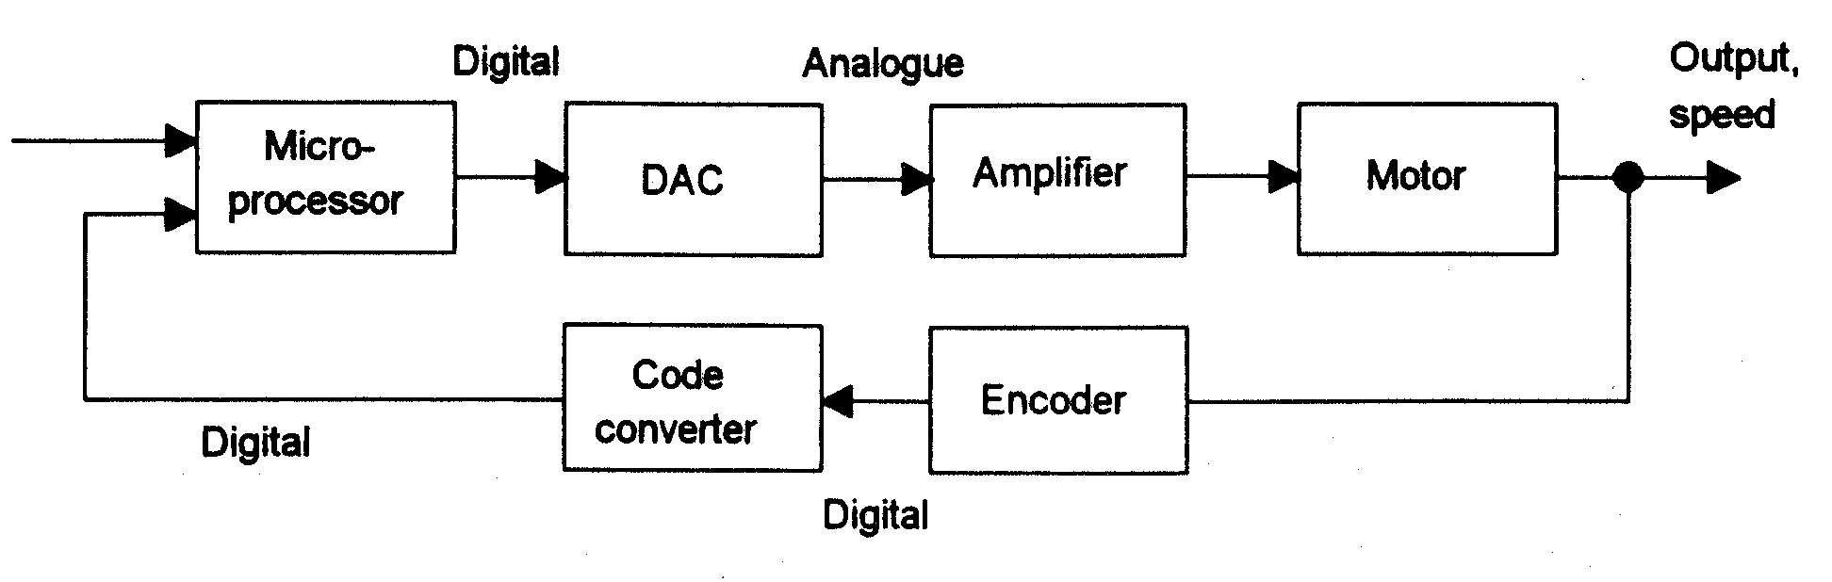
Motor Control – Directional Control
However ADC and DAC must be used on the signals entering and leaving the microprocessor.
Alternatively, a digital feedback signal can be provided by replacing the tachometer with an encoder for measuring the output speed. However, DAC must be used to condition the output from the microprocessor.

Slide 41
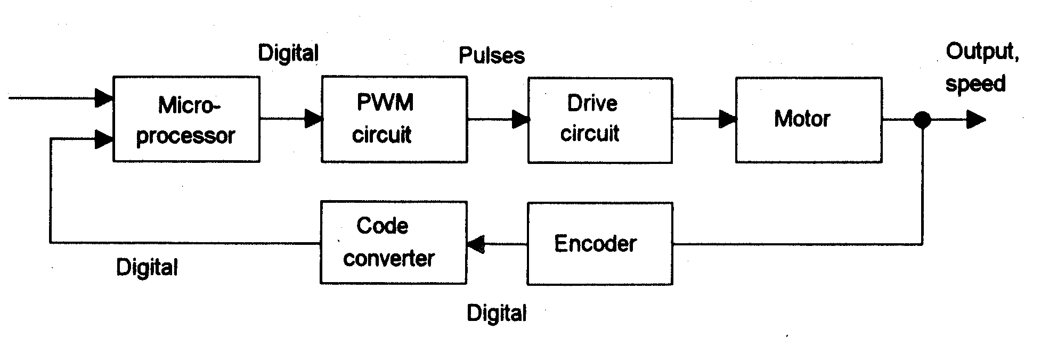
Motor Control – Directional Control
A fully digital system can be obtained by using PWM to control the average voltage applied to the armature.

Slide 42
Summary

Slide 43
Electrical Motor Summary
Motor Feature | Brushed DC | Stepper | Brushless DC | PMAC
Max Speed | Medium | Low | High | High(er)
Maintenance | High | Low | Low(er) | Low(est)
Motor & Controller Cost | Low | Low | Medium | High
Torque Ripple | Medium | High | Medium | Low
Shaft Position Encoder? | None | None | Low Resolution (cheap) | High Resolution (expensive)

Slide 44
Torque Requirements

Slide 45
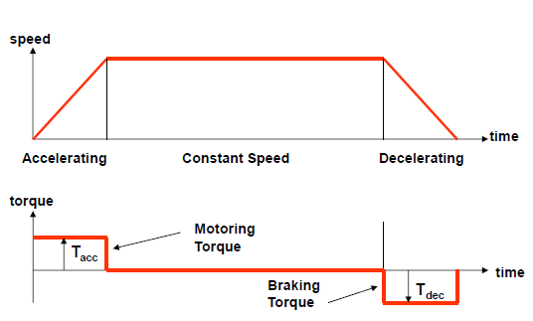
Torque Requirements for Trapezoidal Motion
Consider a motor driving a purely inertial load. What are the torque requirements on the motor during a trapezoidal position change?
T_{acc} – torque required for acceleration
T_{dec} – torque required for deceleration

Slide 46
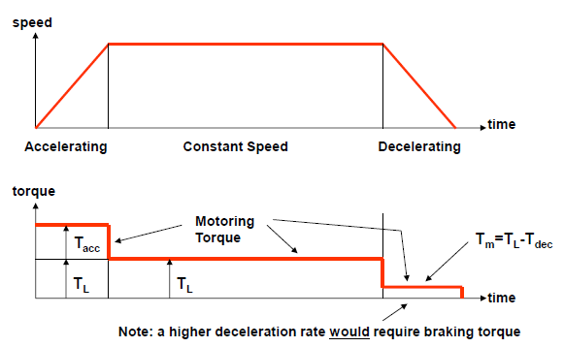
Torque Requirements for Trapezoidal Motion
Consider now a motor driving an inertial plus a fixed load. What are the torque requirements on the motor during a trapezoidal position change?
T_{acc} – torque required for acceleration
T_{L} – torque required for moving the load
T_{dec} – torque required for deceleration
T_{m} – torque required by the motor

Slide 47
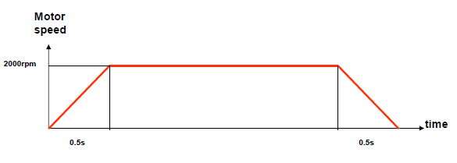
Torque Requirements for Trapezoidal Motion - Example
A robotic arm can be approximated to a 2kg concentrated mass at a distance of 30cm from the actuator/gearing plus a fixed load torque of 2Nm. A gear ratio of 10 has been chosen for this application. The motor inertia can be approximated to a cylinder of diameter 10cm with a mass of 1kg. Determine the motor torque requirements for the following trapezoidal move:

Slide 48
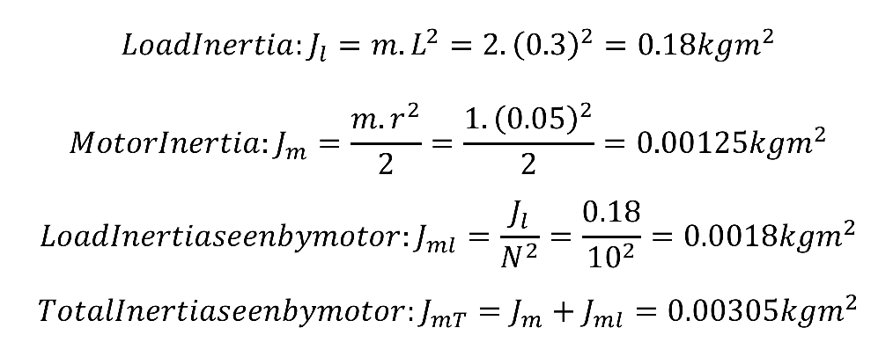
Torque Requirements for Trapezoidal Motion - Example

Slide 49

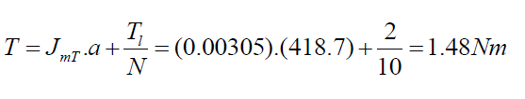
Torque Requirements for Trapezoidal Motion - Example
Acceleration of System:
In this example the acceleration and deceleration have the same magnitude
Required motor torque during acceleration is:

Slide 50

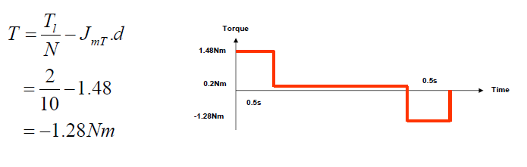
Torque Requirements for Trapezoidal Motion - Example
Motor torque during fixed speed period:
Motor Torque requirements during deceleration:

Slide 51
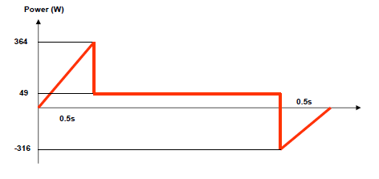
Torque Requirements for Trapezoidal Motion - Example
Assuming a motor efficiency of 85% determine the instantaneous input motor power during the trapezoidal move:
Motor Output Power = Speed (rad/s) x Torque (Nm)
Motor Supply Power = (Speed x Torque)/(Efficiency/100)

Slide 52
Actuation Comparison

Slide 53
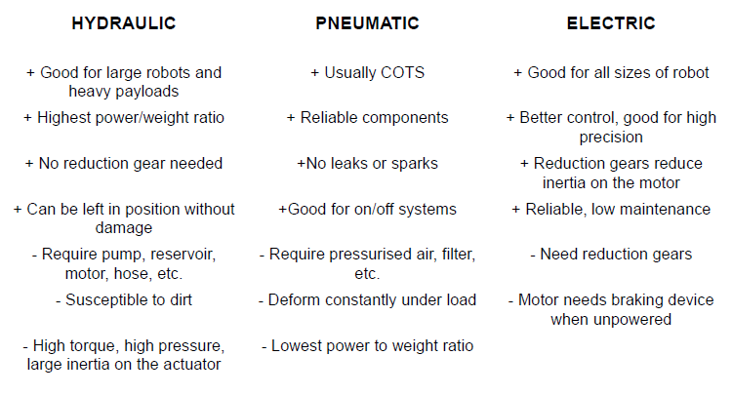
Actuation Comparison

Slide 54
References
Niku, S.B. , Introduction to Robotics, 2nd Edition, Wiley, New Jersey, 2011.
Bolton, W. , Mechatronics, 2 nd Edition, Longman, New York, 2000

